Slide 1


Credit Risk
Boutique sales products Analysis
Prepared by: Jeffking Sterile

Slide 2

Credit default risk
The risk of loss which arises from the debtor being unlikely to repay the amount in full or when the debtor is more than 90 days past is the due date of credit payment, it gives rise to credit default risk.

Slide 3

Problem
This problem is important for the client because if the risk increase, it can totally shut down of the business.

Slide 4

Method
We use tableau to visualize the data and to have a better view to see the insights from the data

Slide 5
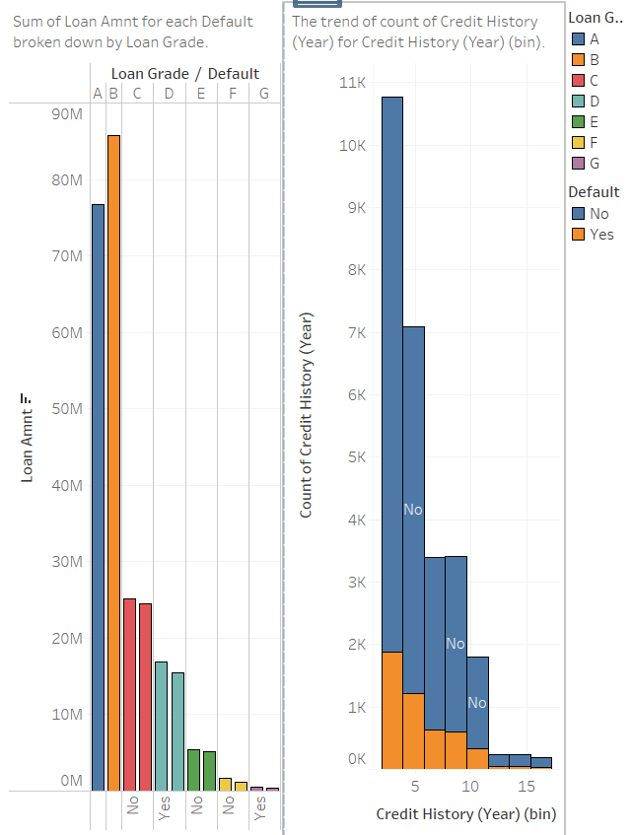
Result
This dashboard is showing how the default risk expeand by year and how many it appears by grade loan

Slide 6
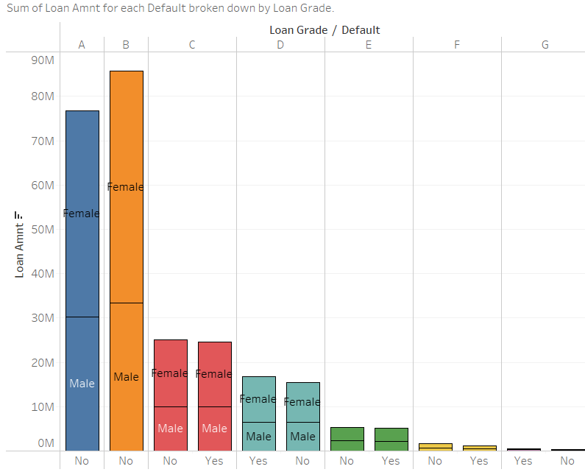
Result
This graph allows us to study the problem according to gender and loan grade . Women make the best loans and at the same time make the loans with the highest risk level. And in the loan grade c and d have more risk

Slide 7
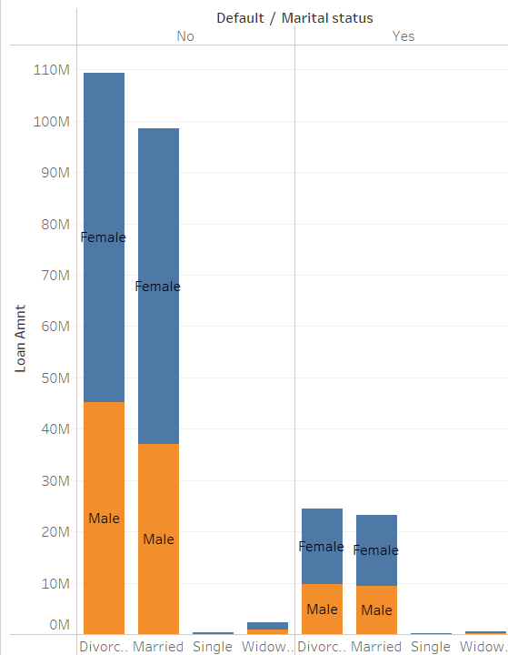
In this graph we have the loan risk amount by martial status and gender

Slide 8
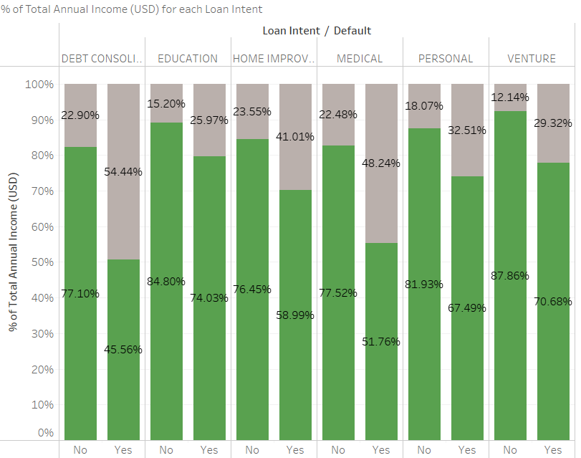
Result

Slide 9
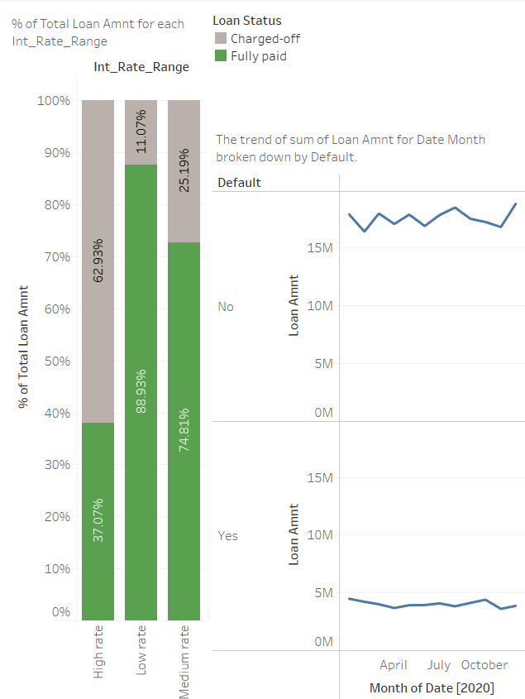
Result
This dashboard offers a more detailed visualization of the problem by loan int rate

Slide 10
Discussion & Proposal Solutions
Solution 1: Leveraging expertise
Using a reputable credit reference agency for more in-depth due diligence can give you invaluable insight and alert you to any potential red flags. You’ll also be able to use the credit report to create a business profile and segment the client appropriately in terms of risk and credit allowance.
Setting accurate credit limits
set credit limits accurately, They’ll need to spend time examining the customer’s finances. Look at the previous three to five years’ reports and question whether sales are trending up or down. These are key indicators of financial health. And make sure to assess the business’s working capital ratio, which indicates its liquidity and ability to meet short-term financial obligations.

Slide 11
Discussion & proposal solution
Solution 2: Accept only the most secure borrowers.
Thus, we will limit the C, D grade loans because the risk of non-payment is high and we will study them thoroughly before granting the loan.
They need to know more their customer, it’s a type of regulation that is imperative in specific sectors, such as financial services. But its principles extend to everyone: don’t offer business to customers unless you have conducted sufficient due diligence

Slide 12

Discussion & Proposed Solution
Alternative solution:Most medium-sized and smaller companies protect themselves against their property and liability exposures by purchasing Commercial insurance, while large corporations and government agencies prefer to use some type of alternative risk financing. However, businesses of any size can employ this tool to enjoy such benefits as improved cash flow and a lower total cost of risk.

Slide 13

Time for questions

